Slide 1
1. How do you design a Highly Available (HA) and Fault Tolerant (Resilient) architecture for an application in AWS?

Slide 2
1. How do you design a Highly Available (HA) and Fault Tolerant (Resilient) architecture for an application in AWS?
Before deciding on a HA and Fault Tolerant architecture, we must understand the tolerance levels of RTO (Recovery Time Objective - Downtime) and RPO (Recovery Point Objective- Data Loss). Less RTO/RPO targets means more cost and complexity.
Do not have a single-point of failure, means deploy the application (or workload) in Multiple Availability Zones (AZs) – Disaster Recovery
ELBs for Fault Tolerance
AWS EC2 ASGs for High Availability
Use IaC Tool to script your infrastructure

Slide 3
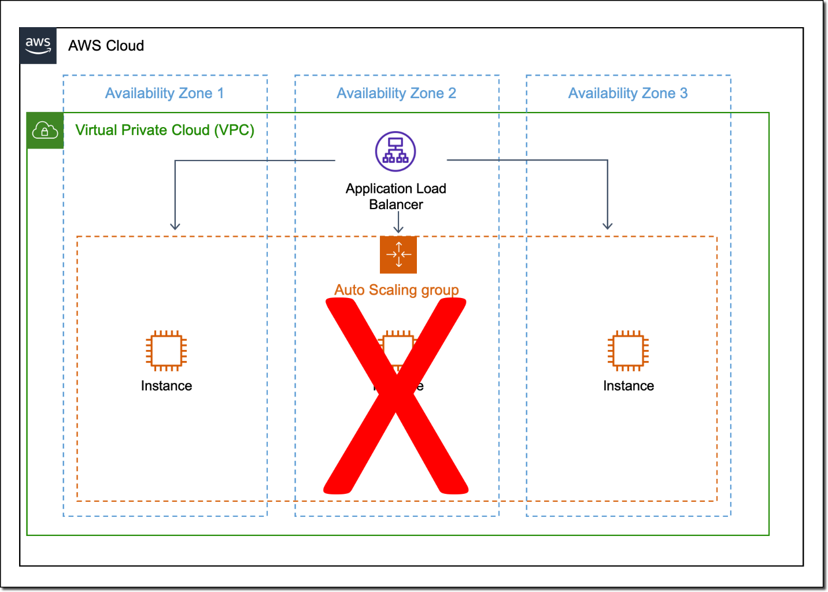

Slide 4
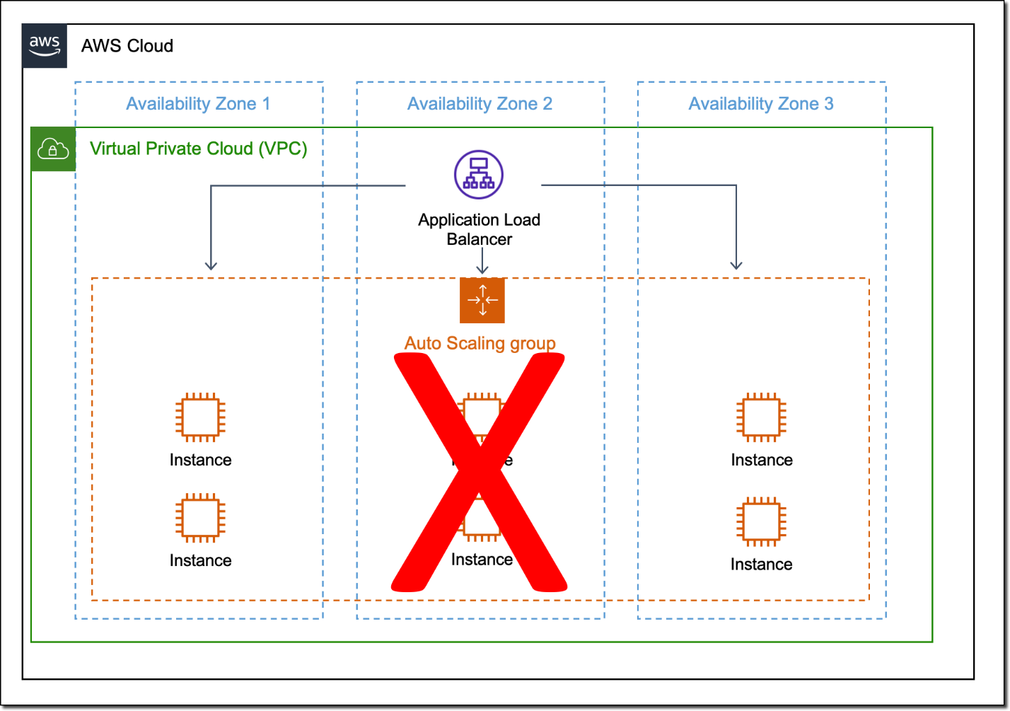

Slide 5
2. What is the default routing algorithm of an Application Load Balancer? Which other algorithm does it support?

Slide 6
2. What is the default routing algorithm of an Application Load Balancer? Which other algorithm does it support?
Default is Round Robin, the other option is Least Outstanding Requests.

Slide 7
3. Which Load Balancer is most suited when you have to handle millions of request per second?

Slide 8
3. Which Load Balancer is most suited when you have to handle millions of request per second?
Network Load Balancers is better suited to handle millions of requests per second with ultra-low latencies.

Slide 9
4. How do you support extra read requests in RDS?

Slide 10
4. How do you support extra read requests in RDS?
Read Replicas: You can create copies of your primary RDS DB instance (writer) to offload read requests from the primary instance. The data is copied asynchronously. In most cases (but there are some exceptions) you can have 5 read replicas of your RDS instance.

Slide 11
5. How do you achieve disaster recovery in RDS?

Slide 12
5. How do you achieve disaster recovery in RDS?
Using Multi-AZ feature. You can enable Multi-AZ for an RDS instance that is going to create a copy of the primary instance in another Availability Zone. In case of a failure, the traffic is automatically routed to the secondary instance. The data is copied synchronously from primary to the secondary instance.

Slide 13
6. What is cross-zone load balancing?

Slide 14
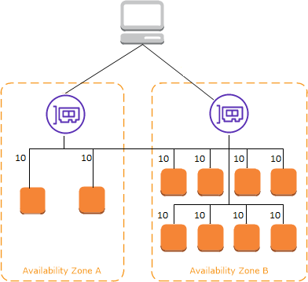
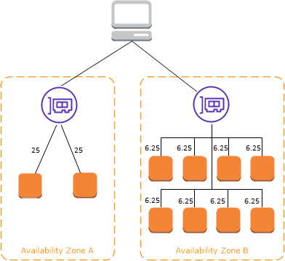
6. What is cross-zone load balancing?
The following diagrams demonstrate the effect of cross-zone load balancing with round robin as the default routing algorithm. There are two enabled Availability Zones, with two targets in Availability Zone A and eight targets in Availability Zone B. Clients send requests, and Amazon Route 53 responds to each request with the IP address of one of the load balancer nodes. Based on the round robin routing algorithm, traffic is distributed such that each load balancer node receives 50% of the traffic from the clients. Each load balancer node distributes its share of the traffic across the registered targets in its scope.
If cross-zone load balancing is enabled, each of the 10 targets receives 10% of the traffic. This is because each load balancer node can route its 50% of the client traffic to all 10 targets.

Slide 15
7. How an EC2 instance in an AutoScaling Group is replaced based on the health checks?

Slide 16
7. How an EC2 instance in an AutoScaling Group is replaced based on the health checks?
An ASG continuously monitors the health of each instance. All instances in an Auto Scaling group start with a Healthy status. Instances are assumed to be healthy unless Amazon EC2 Auto Scaling receives notification that they are unhealthy. It can receive notifications from various sources when an instance becomes unhealthy and must be replaced. These sources include: Amazon EC2, Elastic Load Balancing, VPC Lattice, Amazon EBS, Custom health checks that you define. When an InService instance becomes unhealthy, it is replaced with a new one to maintain the desired capacity of the group.

Slide 17
8. What are Lifecycle Hooks in AutoScaling Groups?

Slide 18
8. What are Lifecycle Hooks in AutoScaling Groups?
A lifecycle hook lets you perform custom actions on instances. It provides you a specified amount of time (1 hour by default) to wait for the action to complete before the instance transitions to the next state. Examples:
1. When a scale-out event occurs, your newly launched instance completes its startup sequence and transitions to a wait state. While the instance is in a wait state, it runs a script to download and install the needed software packages for your application, making sure that your instance is fully ready before it starts receiving traffic. When the script is finished installing software, it sends the complete-lifecycle-action command to continue.
2. When a scale-in event occurs, a lifecycle hook pauses the instance before it is terminated and sends you a notification using Amazon EventBridge. While the instance is in the wait state, you can invoke an AWS Lambda function or connect to the instance to download logs or other data before the instance is fully terminated.

Slide 19
9. How do you peer 2 VPCs?

Slide 20
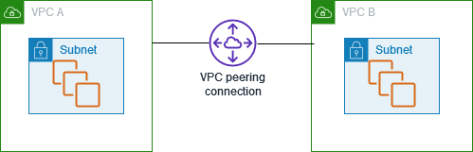
9. How do you peer 2 VPCs?
A VPC peering connection is a networking connection between two VPCs that enables you to route traffic between them using private IPv4 addresses or IPv6 addresses. Instances in either VPC can communicate with each other as if they are within the same network. You can create a VPC peering connection between your own VPCs, or with a VPC in another AWS account. The VPCs can be in different Regions (also known as an inter-Region VPC peering connection).
Create (send the request from VPC A and accept from VPC B)
Update Route Tables in both VPCs
Reference peer SGs
To enable VPCs to resolve public DNS hostnames to private IP addresses, DNS hostnames and DNS resolution in both VPCs should be enabled
Enable DNS resolution in the peering connection as well

Slide 21
10. What are VPC Endpoints?

Slide 22
10. What are VPC Endpoints?
A VPC endpoint enables customers to privately connect to supported AWS services and VPC endpoint services powered by AWS PrivateLink. Amazon VPC instances do not require public IP addresses to communicate with resources of the service. Traffic between an Amazon VPC and a service does not leave the Amazon network.
Features: virtual devices, scaled horizontally, and highly available
Types: Interface and Gateway
An interface endpoint is a collection of one or more elastic network interfaces with a private IP address that serves as an entry point for traffic destined to a supported service.
https://docs.aws.amazon.com/vpc/latest/privatelink/aws-services-privatelink-support.html
Gateway VPC endpoints provide reliable connectivity to Amazon S3 and DynamoDB without requiring an internet gateway or a NAT device for your VPC. Gateway endpoints do not use AWS PrivateLink, unlike other types of VPC endpoints.

Slide 23
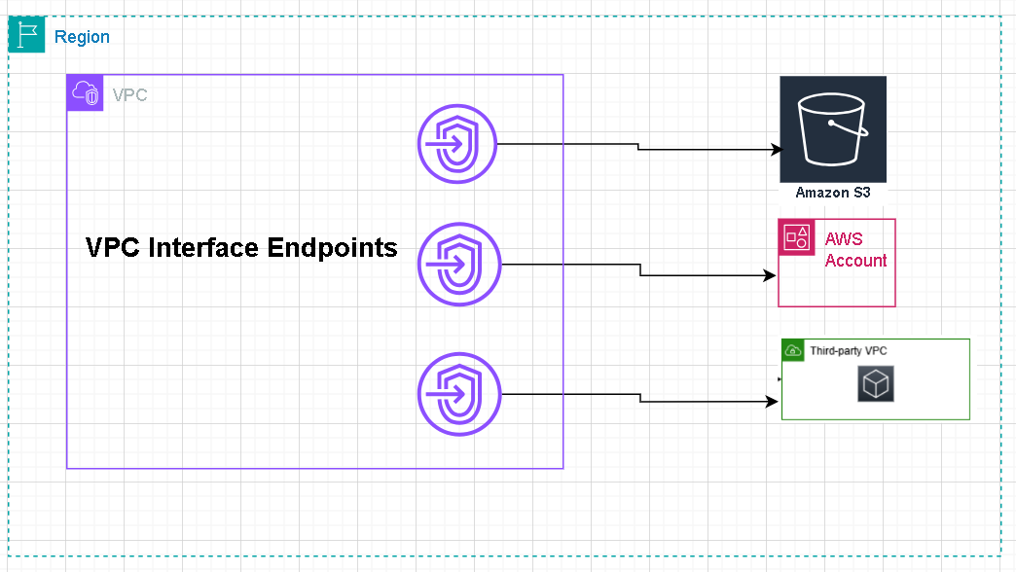
AWS PrivateLink (Interface Endpoint)

Slide 24
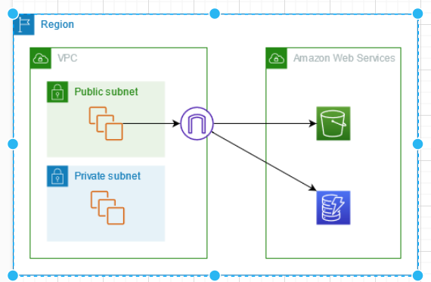
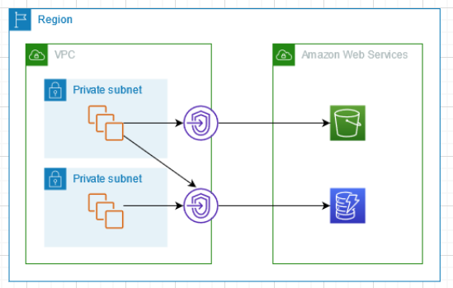
AWS Gateway Endpoint

